Slide 1

New Frontier for Electricity Cost Saving in Mexico
Presented by Electric Foresights
Andres Zamora
Jason Kang
Pavel Golukhin
Steven Lin

Slide 2
Traditional electricity cost saving focus on consumption control
1. Consumption cutting
2. Energy audit
Cost Savings
3. Power recycling

Slide 3
Price — the Missing Puzzle!
Electricity Cost = Consumption X Price

Slide 4


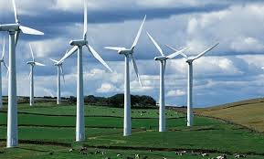
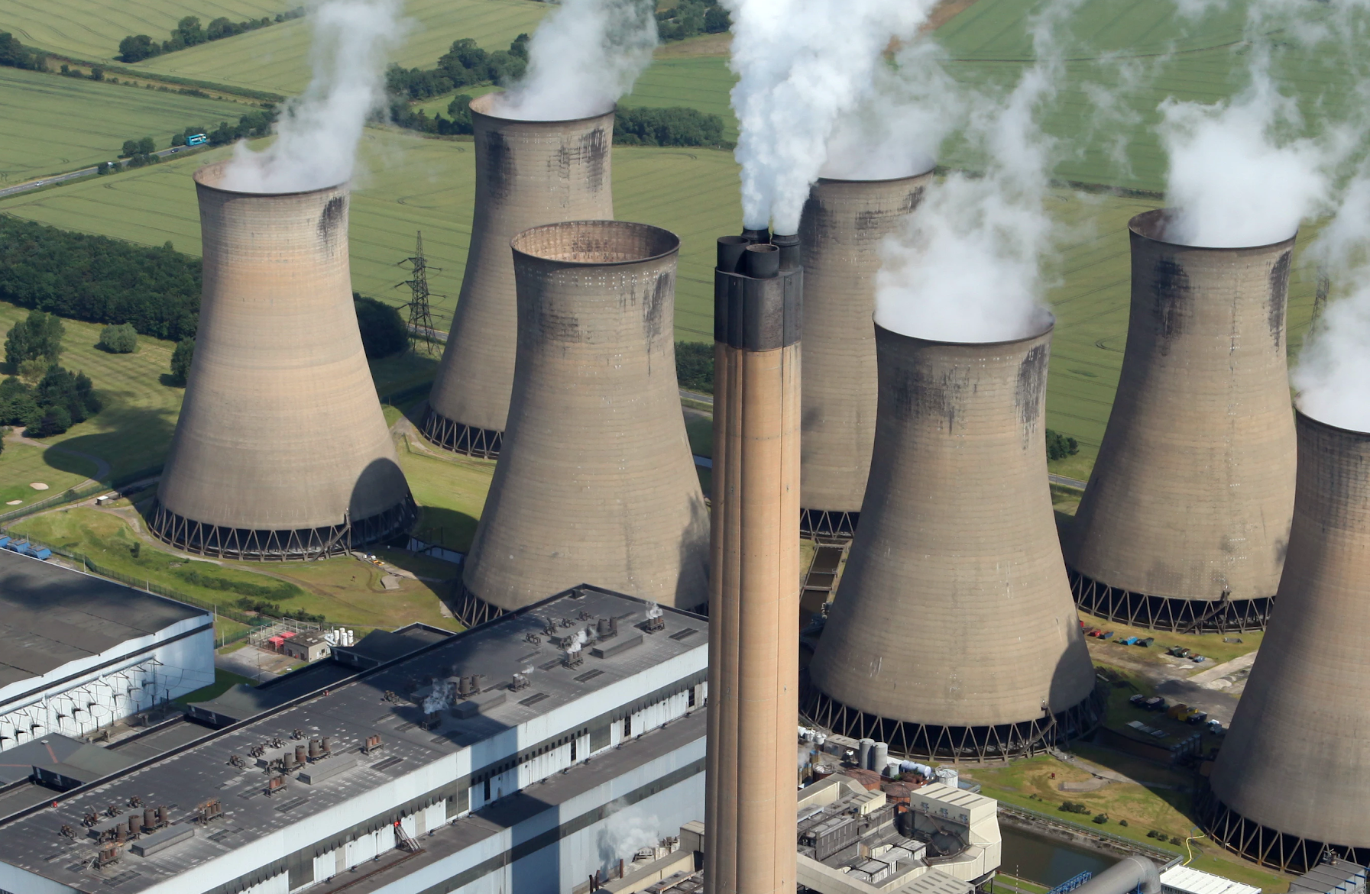
How is the Price Determined?
Users submit daily demand a day before the actual usage
01
Suppliers submit price and their respective capacity
02
Regulators fills the demand by matching the suppliers in ascending order based on their price submitted
03
Usually clean energy suppliers will be matched first due the low variable cost, and traditional power plant will be the last matched due to the high fuel cost.
04
05
The price offered by the last matching supplier will be the price of the electricity.

Slide 5
A Breakdown of Variables that May Impact Price
Price
Who is the Last Supplier
It’s Submitted Cost
Demand and Capacity
No. of Users
Weather
Time
No. Suppliers
Fuel Cost
Exchange Rate
Bidding Strategy
Op-Cost

Slide 6

The Pain Point of Current Solutions
1. Variable
Price is not a stand alone variable
2. Complexity
It depends on so many factors aforementioned
3. Limitation of Model
Statistical measure focusing solely on price doesn’t work very well (ARIMA) due to omitted variable bias.

Slide 7

Our Solution
Autoregressive Recurrent Neural Networks to capture the subtle interactions among various factors affecting the price
Automated Pipeline to gather input variables from multiple sources and generate the most updated hourly forecast 7 days ahead

Slide 8
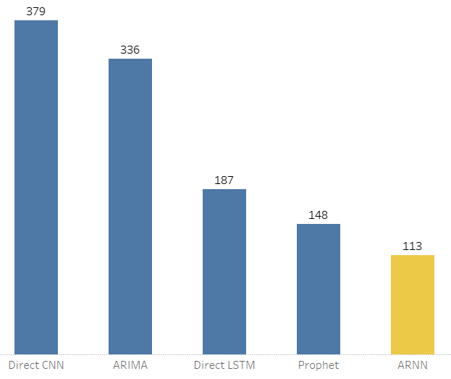
Model Evaluation
Mean Absolute Error (MAE) to measure the unscaled absolute difference between actual and forecast value which is less impacted by outliers
Mean Absolute Error
Winner:
Autoregressive RNN !
Learn More

Slide 9




Key Takeaway
Model
01 Identify underlying factors
02 Neural networks to capture
non-linear relationships
03 No one model fits all
Infrastructure
01 End-to-end AWS infrastructure is scalable and easily customizable
02 AWS Lambda and Cloudwatch to make it super cost-effective
CloudWatch

Slide 10
Product Demo
Electric Foresights
Forecast Dashboard
Check It Out!

Slide 11
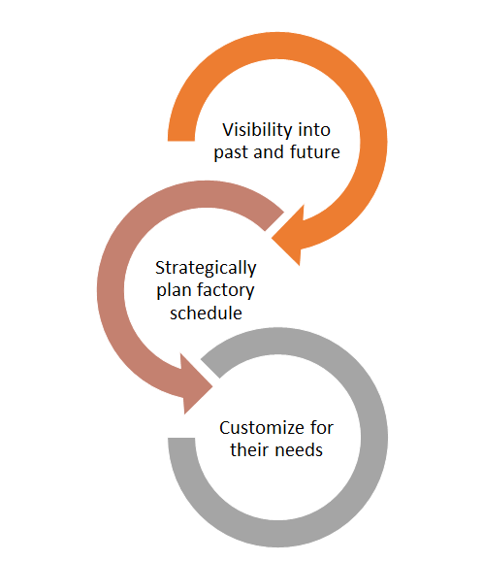
What our product means to you ?
Our product provides insights into the future
The foresights enables a brand new array of cost-saving strategies
Alternative operating schedules
Targeted peak-shaving
Optimization of the power storage solutions
Strategic engagement of the backup power source or co-generation
And more...

Slide 12
Use Case Demo -- Client Information
Client Name: Teleflex
Business: Manufacturer of Medical Equipments
Operating Days: Mon to Fri
Operating Hours: 24 hrs
Hourly Consumption: 3.55 MW/h
Max Consumption Cutting Rate: 70%
Maximum Hours to Practice Consumption Cutting: 6 Hrs.
Need to Catch Up During Off-Peak Hours: No

Slide 13
Use Case Demo
Click on the following link to find out how much you can saving by using our product:
Electric Foresights
Case Demo and Savings Estimator
Check It Out!

Slide 14
Quick Recap
Identified the new frontier of electricity cost saving
Solved the problem of electricity price forecasting in Mexico
Unlocked new strategies for more electricity cost savings
Could help thousands of factories in Mexico to save millions of dollars a year.

Slide 15
Next Steps and Tailored Solutions
01
We can tailor the user dashboard according to your information needs and offer you API access for easier system integration.
We can expand the forecasting region to where your factories are located through transfer learning.
We can work with energy consultant to provide you tailored power solution that optimizes your cost saving.
02
03

Slide 16

Q & A
Thank You

Slide 17
Reference

Slide 18
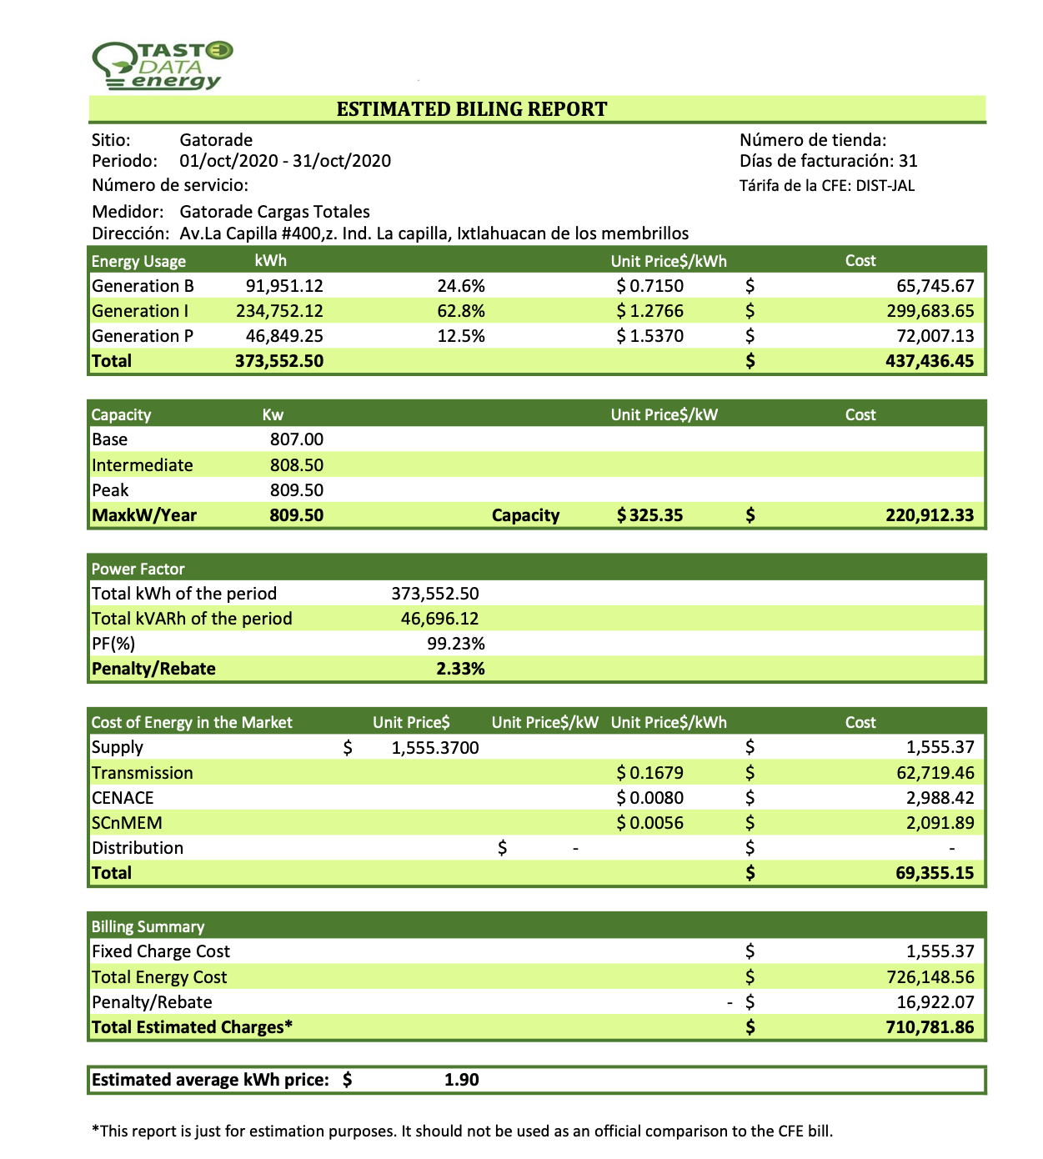

Slide 19
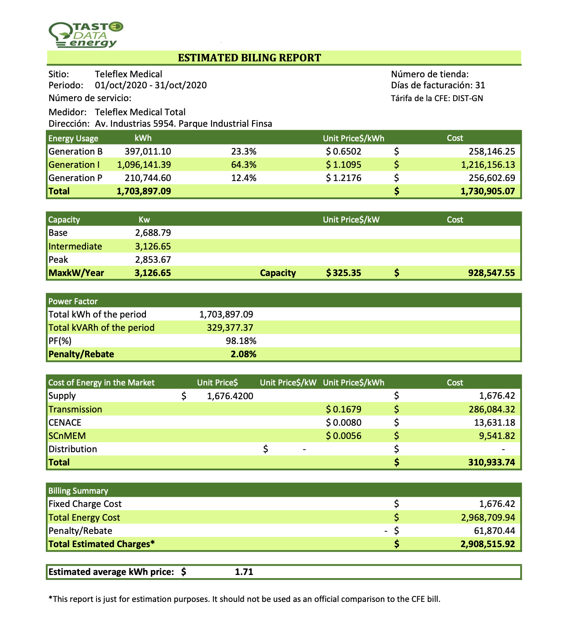

Slide 20
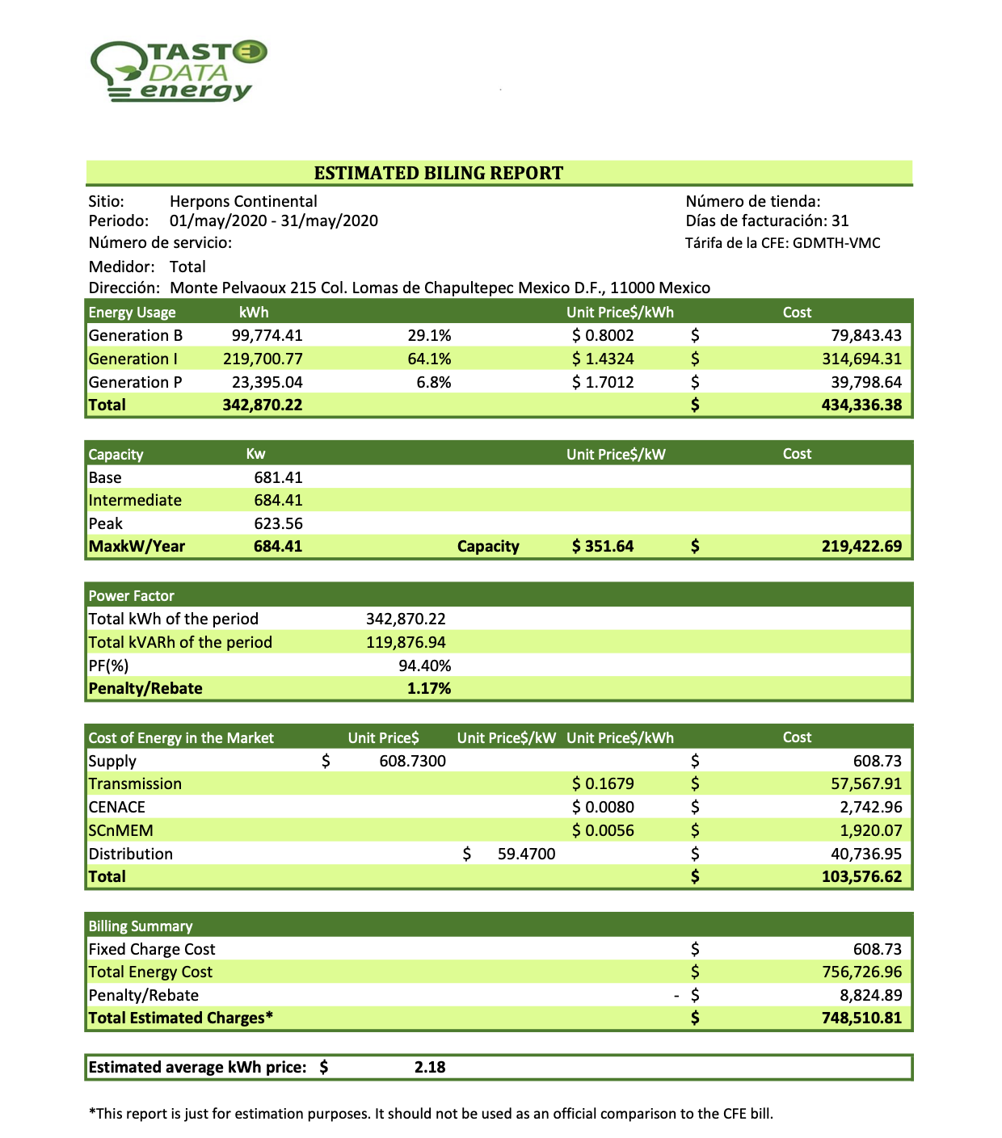

Slide 21
Use Cases
Models | Operating Hours | Hourly Consumption | Peak Shaving Rate | Peak Shaving Hours | Annual Savings in Mexican Pesos
Gatorade (Sports drink) | 24 | 0.778 MW | 0.7 | 6 | 953,101
Litoplas (store and bottled products for Nestle) | 24 | 0.714 MW | 0.65 | 7 | 925,735
Teleflex (Medical ) | 24 | 3.551 MW | 0.7 | 6 | 4,334,839

Slide 22
Model Comparison
Models | ME | MAE | MAPE
Our ARNN Model | -10.02 | 112.54 | 24%
Facebook Prophet | -4.57 | 148 | 26%
Direct LSTM | 62.70 | 187.26 | 41%
ARIMA | -335.80 | 335.80 | 60%
Direct CNN | 67.91 | 379.15 | 78%

